Slide 1
Move Element To End
2023/03/05

Slide 2
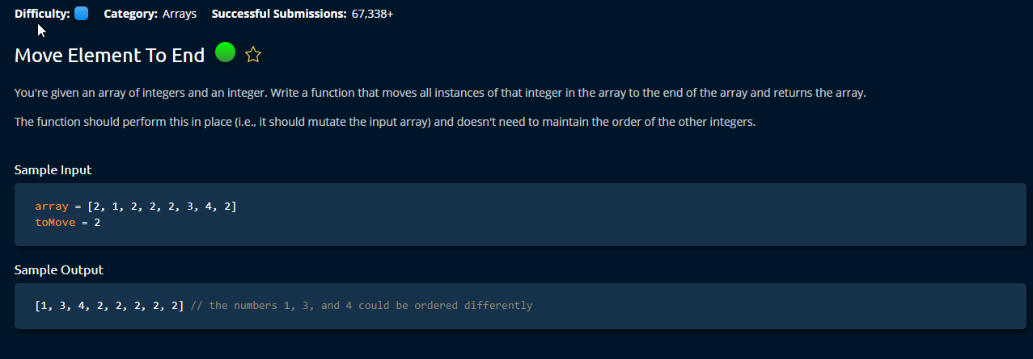

Slide 3
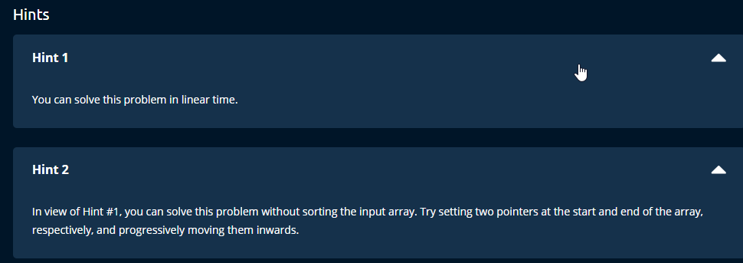

Slide 4
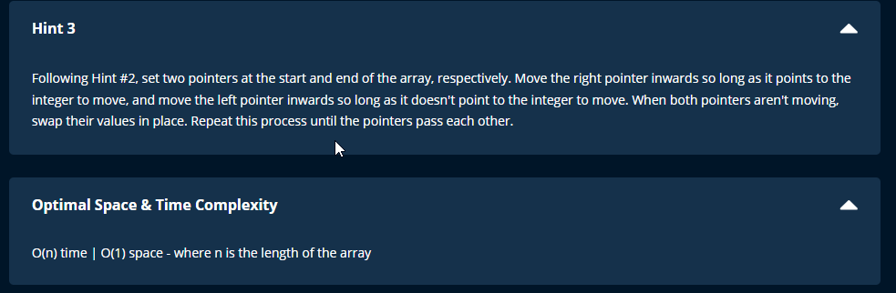

Slide 5
NOtes
# time = O(n) \ space = O(1)
# SPACE COMPLEXITY
# do the move in place to maintain space O(1)
# TIME COMPLEXITY
# to maintain O(n)(linear time), don't sort.
# linear time = traversing the entire array
# only travel the array once.
# do not need to travel the array for each number

Slide 6
PRocess
# start with two pointers on each end of the array.
# move the start pointer if it is not equal to our target.
# move end pointer if it is equal to our target
# swap the number if the start pointer == target num and right pointer != target num
# then we have to move both start and end pointers one unit.
# but can leave end pointer bc while loop will take care of it.
# when the pointers traverse each other(idxStart > idxEnd), they means we have checked the entire array for targetnum placement.
# tips : here we only use while loop for endIdx, bc sometime the target number can come in a series
# using while instead of if can make the program faster.

Slide 7
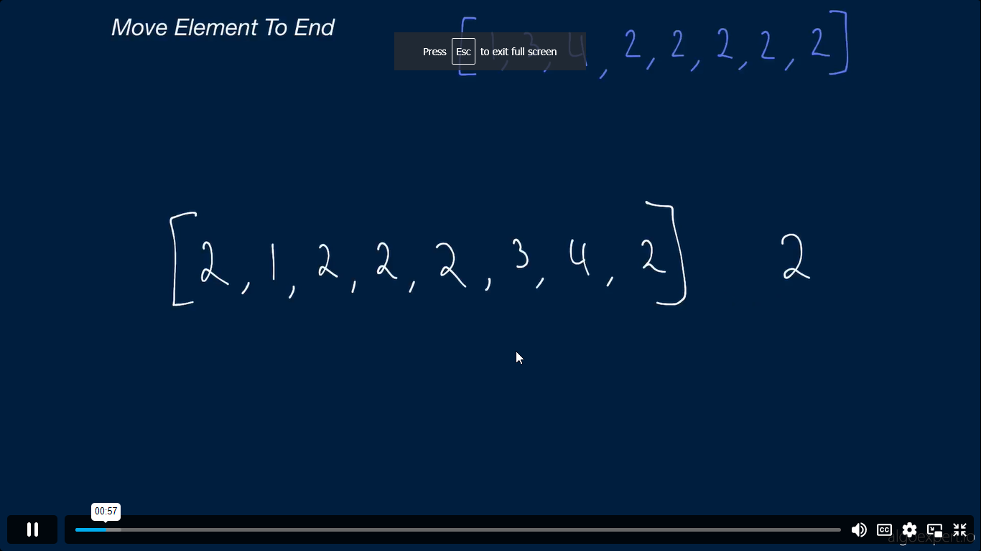

Slide 8
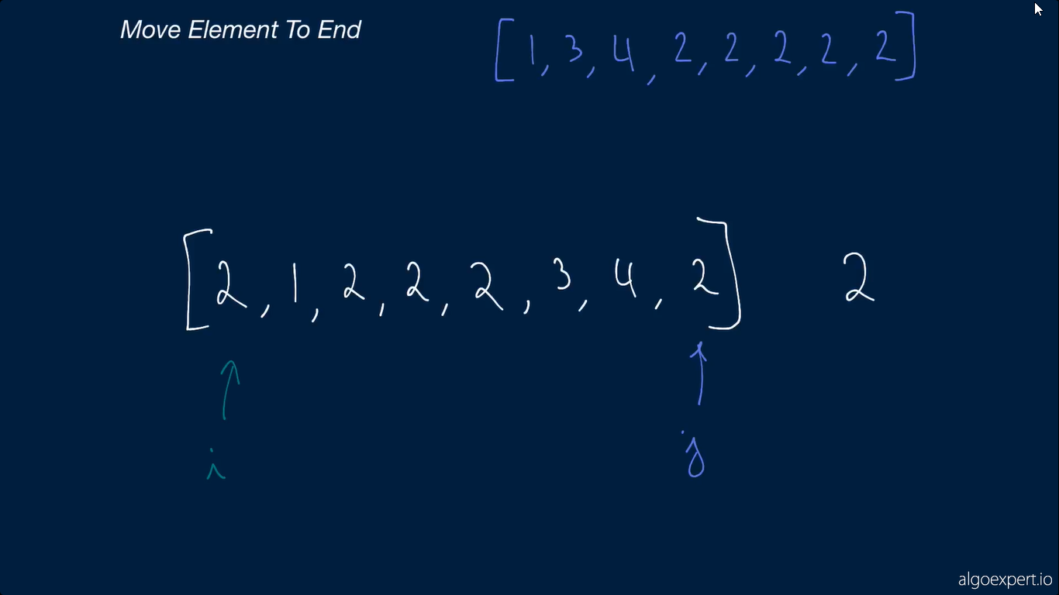

Slide 9
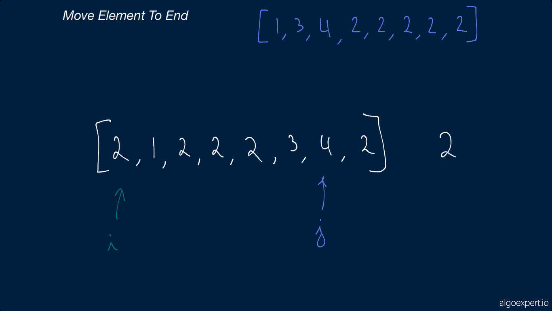

Slide 10
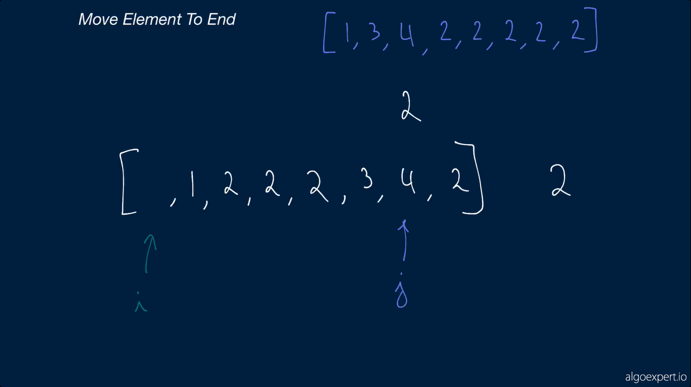

Slide 11
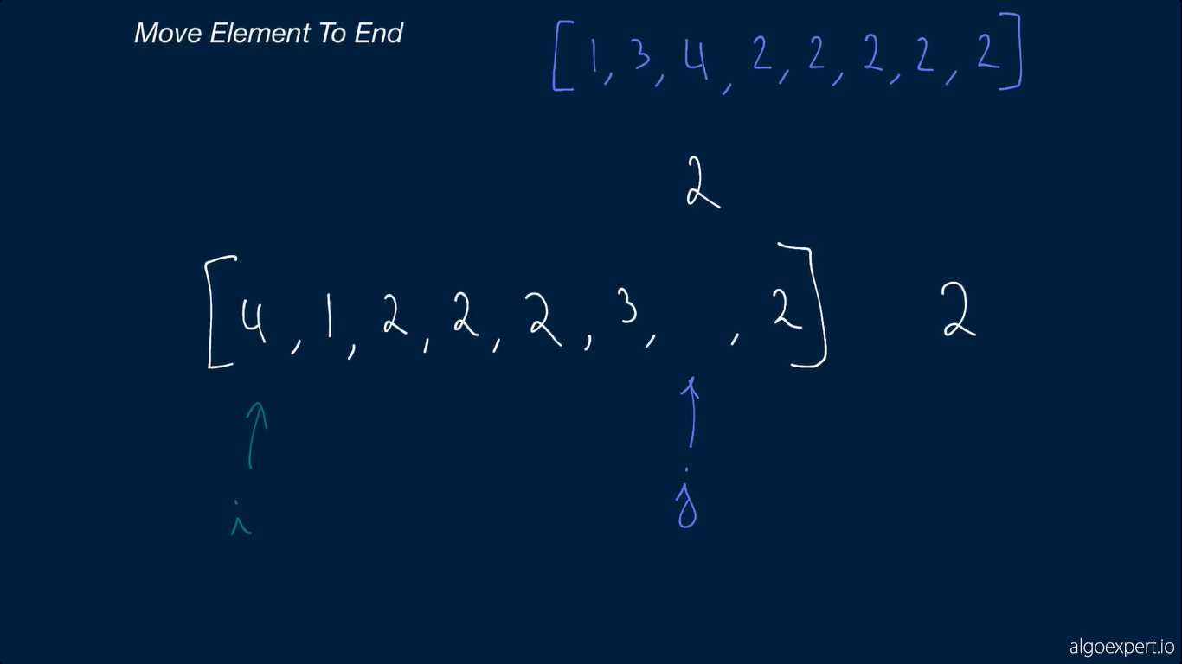

Slide 12


Slide 13
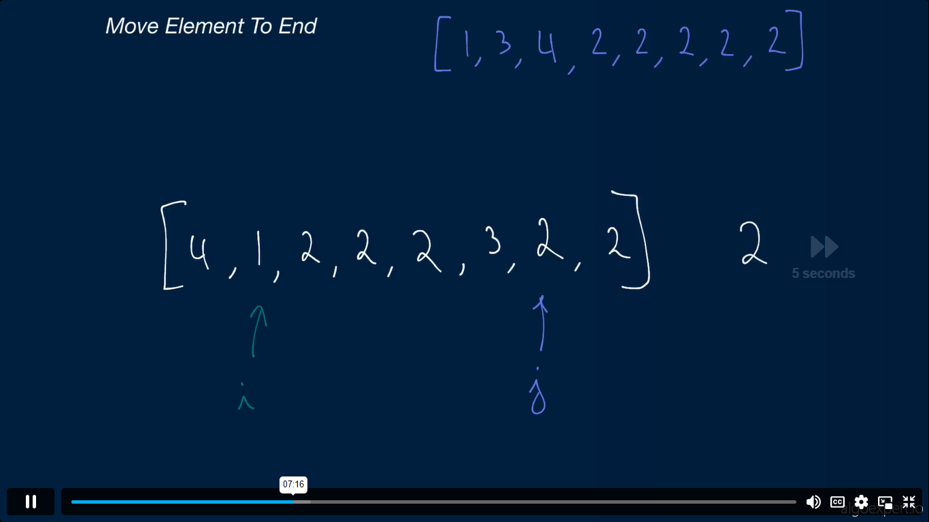

Slide 14
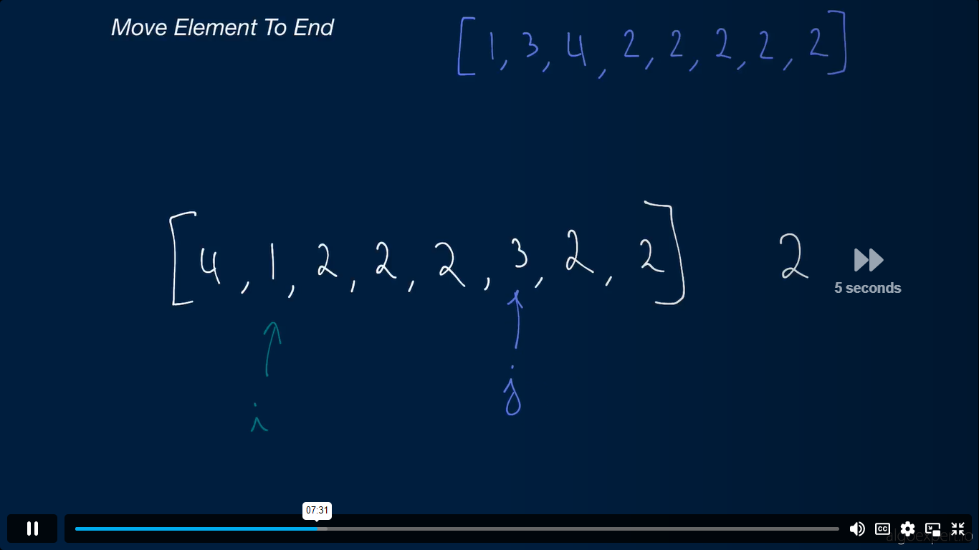

Slide 15
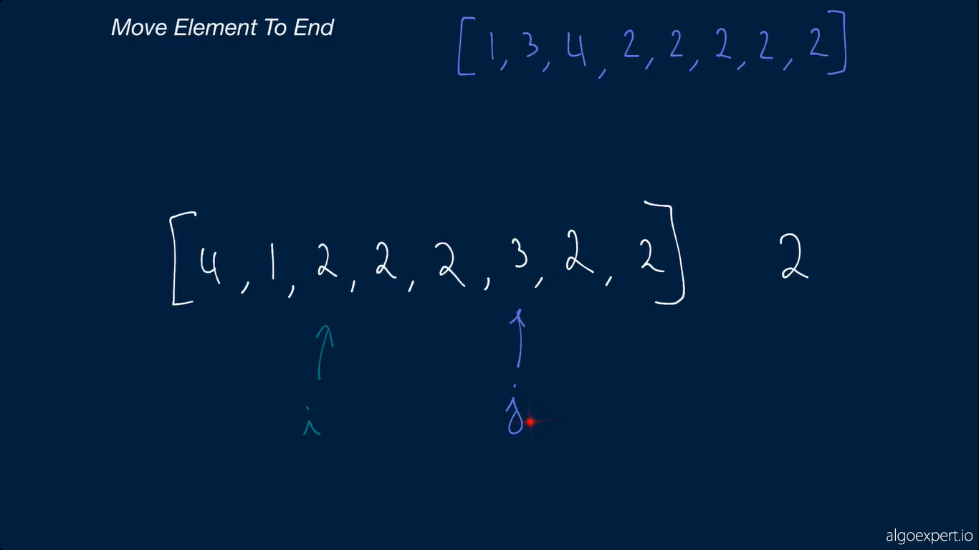

Slide 16
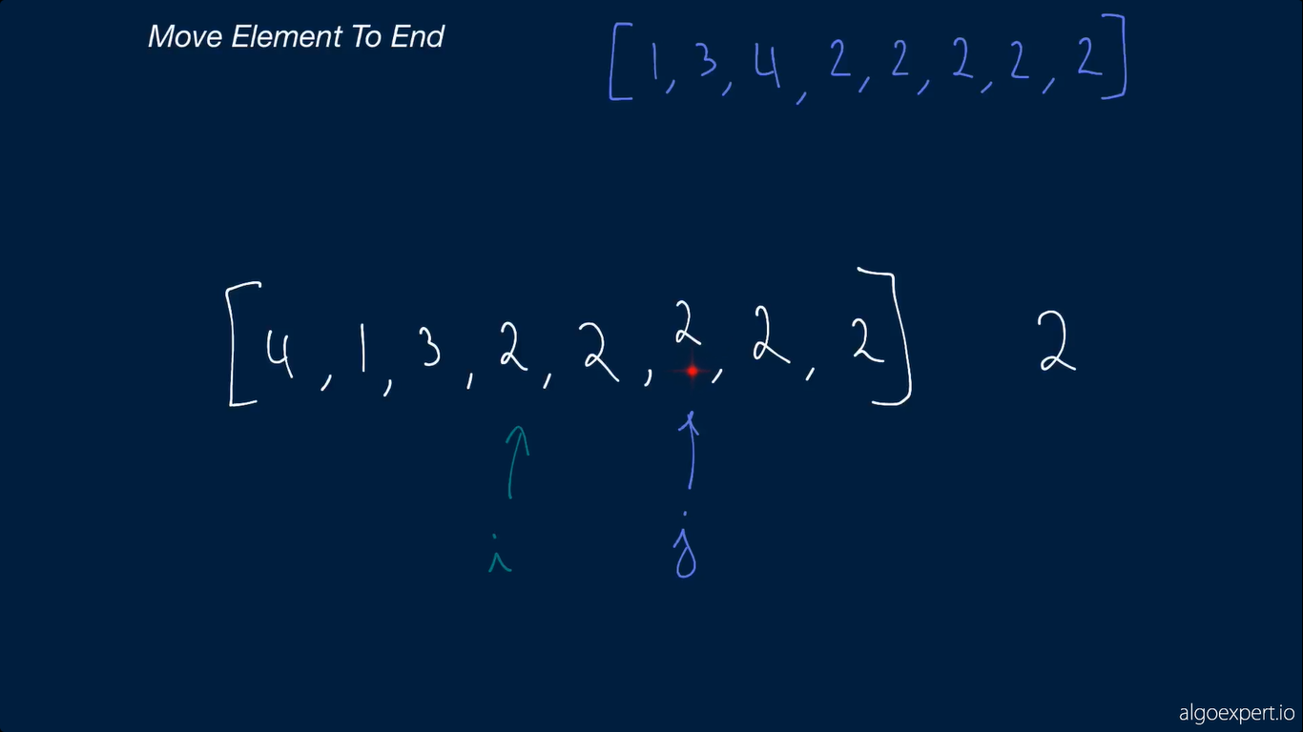

Slide 17
